Slide 1
Serverless Real-Time Credit Card Fraud Detection Solution
CMPE-255
Junjie Zhu
(Application Track)

Slide 2
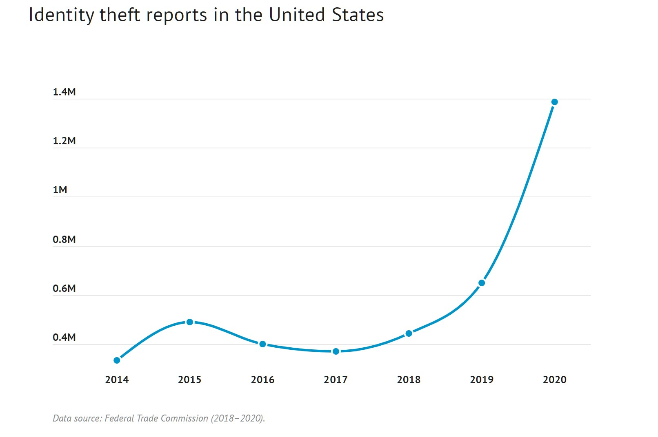
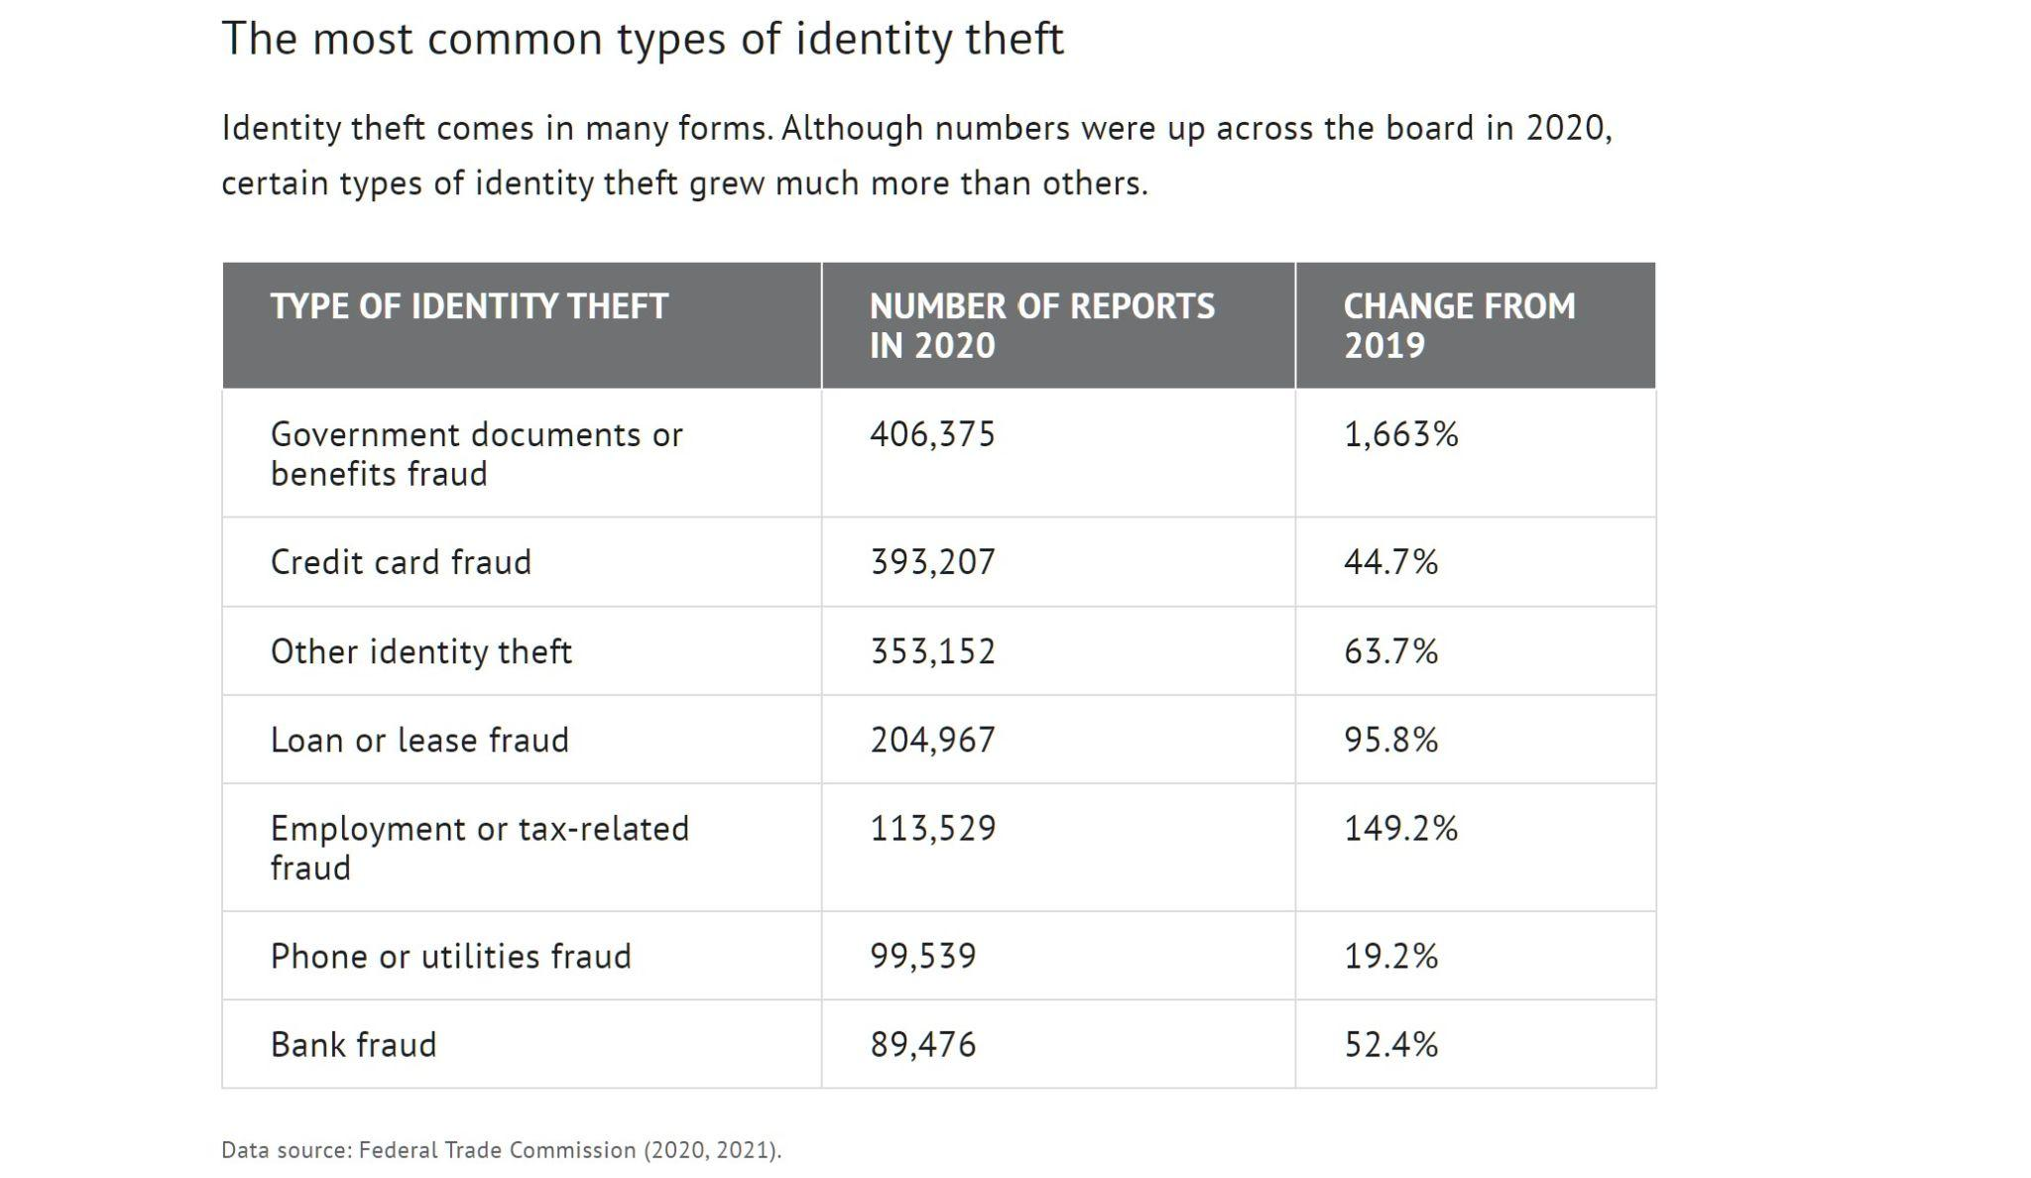
Problem Statement
Credit Card Fraud Problem -
According to FTC, the number of credit card fraud report has been increasing, and it has the 2nd largest amount of fraud report across all identity theft report.
How to detect these fraud transactions?
To detect them, we need to know:
what kind of transactions looks normal?
what kind of transactions looks like fraud?
how to predict if a transactions is normal or fraud?
To make it useful in real life, it would be great if it is a real-time prediction and can handle input in scale!

Slide 3

Proposed Solution
Deploy ML model on GCP for real time prediction in scale -
consume incoming transaction details from Cloud Pub/Sub
does data preprocessing (by calling Firestore for data enrichment using transaction history)
invokes multiple ML models deployed on AI Platform
stores the prediction results to BigQuery and
sends notification to another Pub/Sub topic when a transaction is predicted fraudulent for downstream consumptions

Slide 4
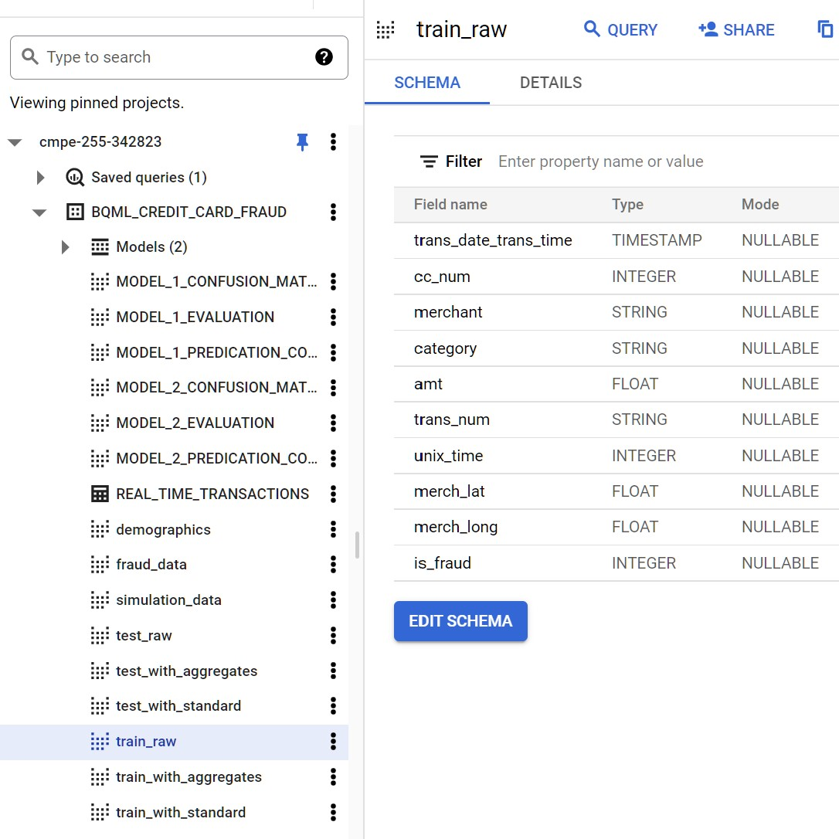
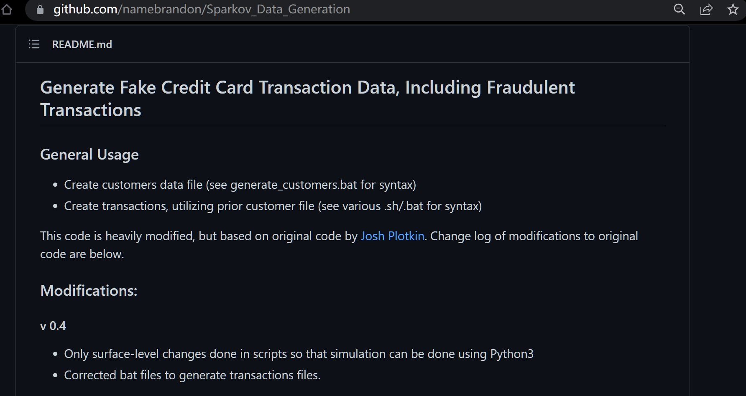
Simulated Dataset
Open source credit card transaction and customer info generator -
Utilized it to get raw data for training, testing, and simulation

Slide 5
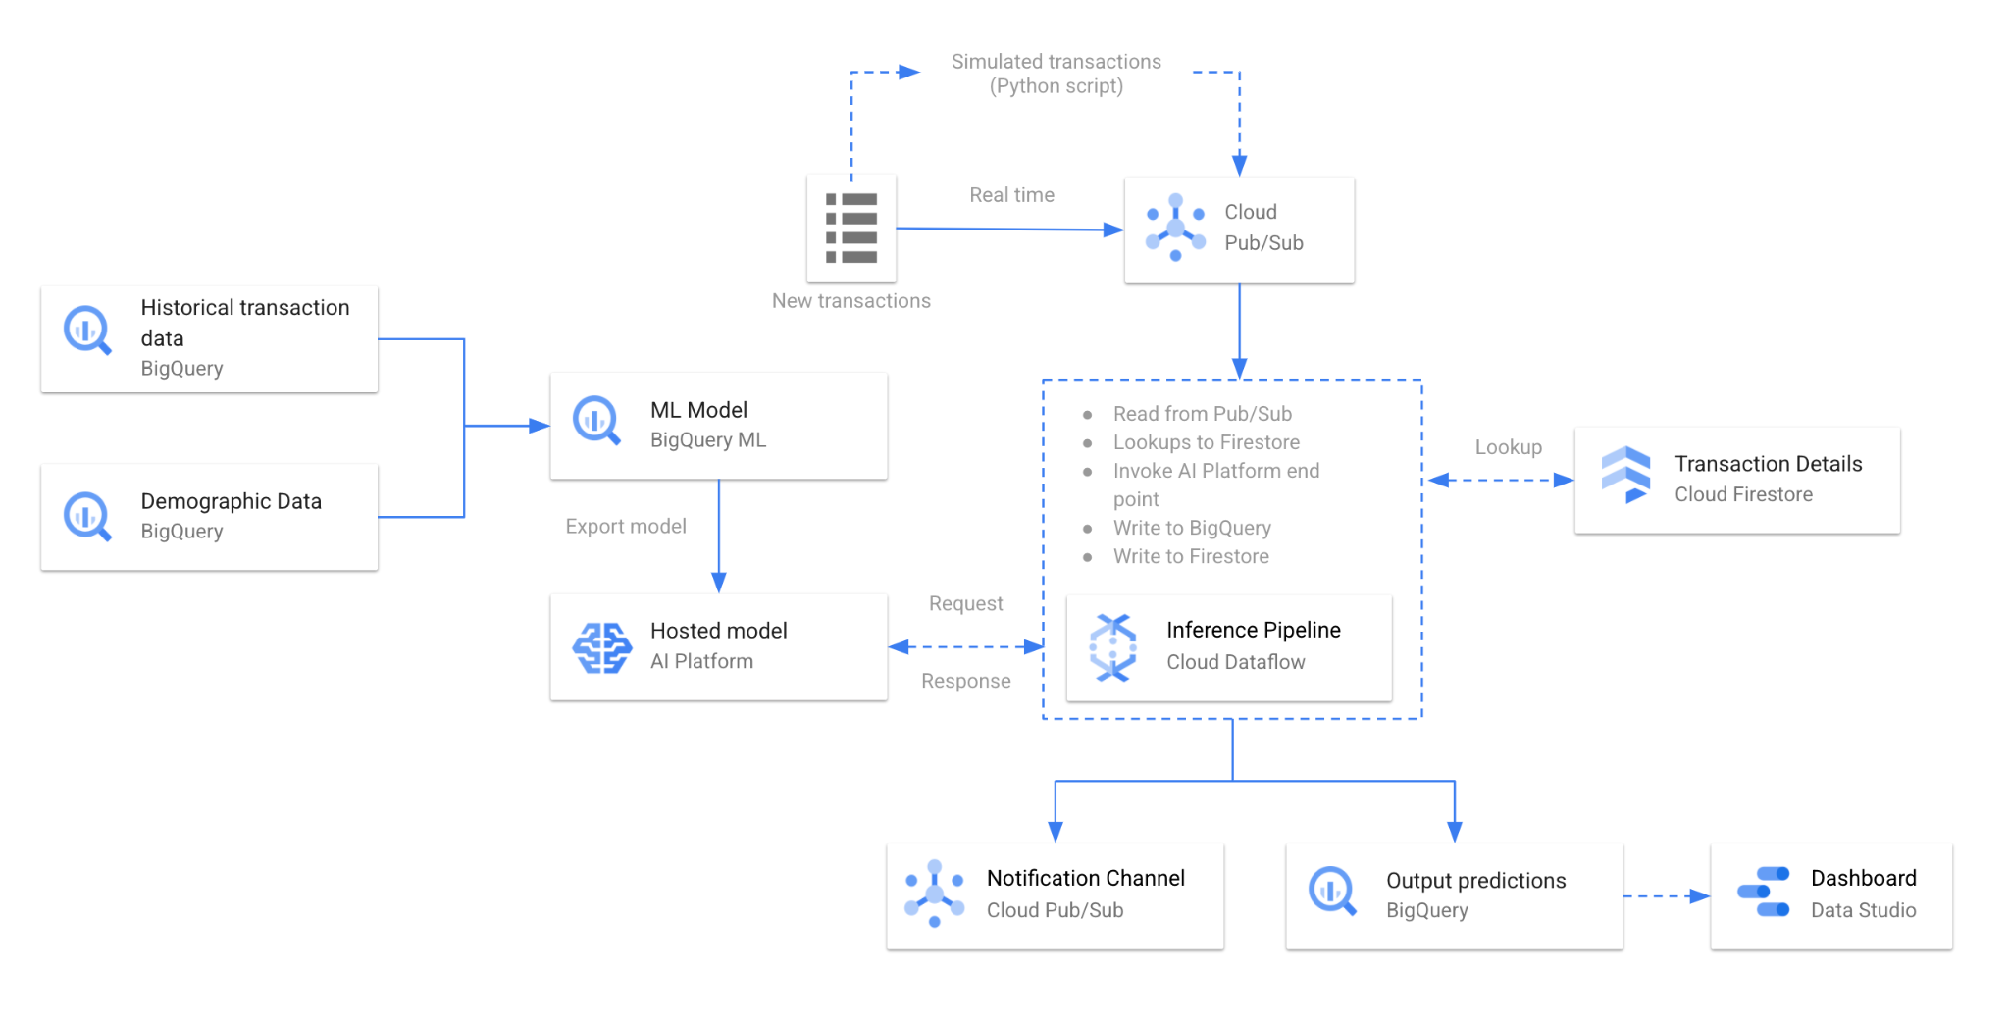
Workflow Architecture

Slide 6
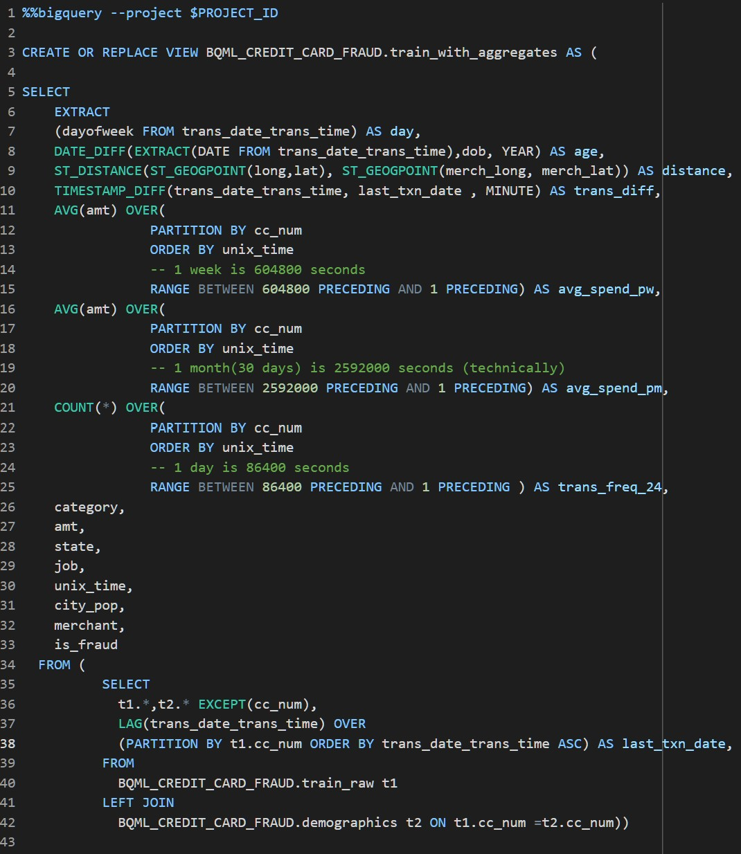
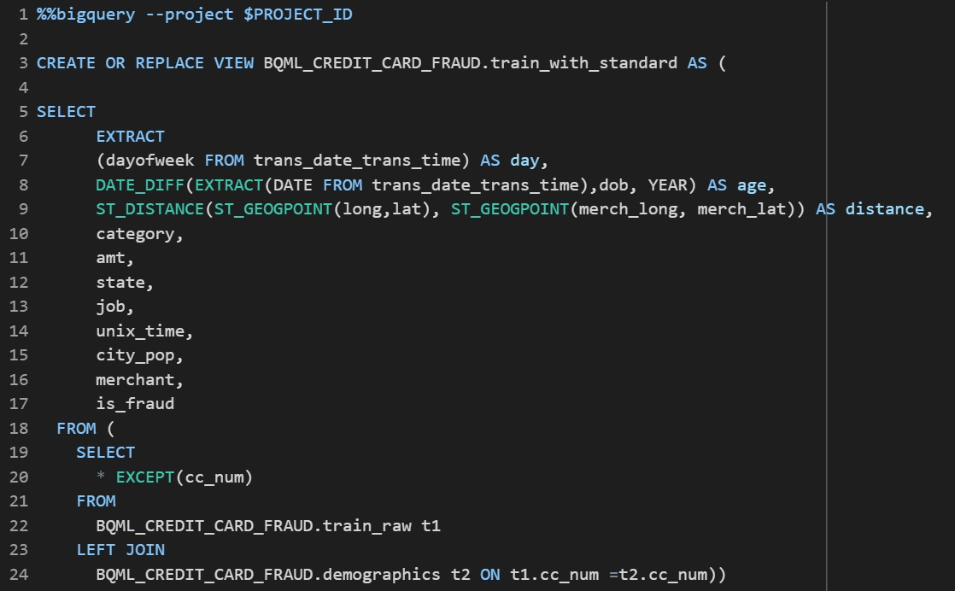
Data Preprocessing
Preprocessed two training data set -
Train_with_standard: Training data for standard model (model 1)
Train_with_aggregates: Training data for aggregate model (model 2, 3, 4)

Slide 7
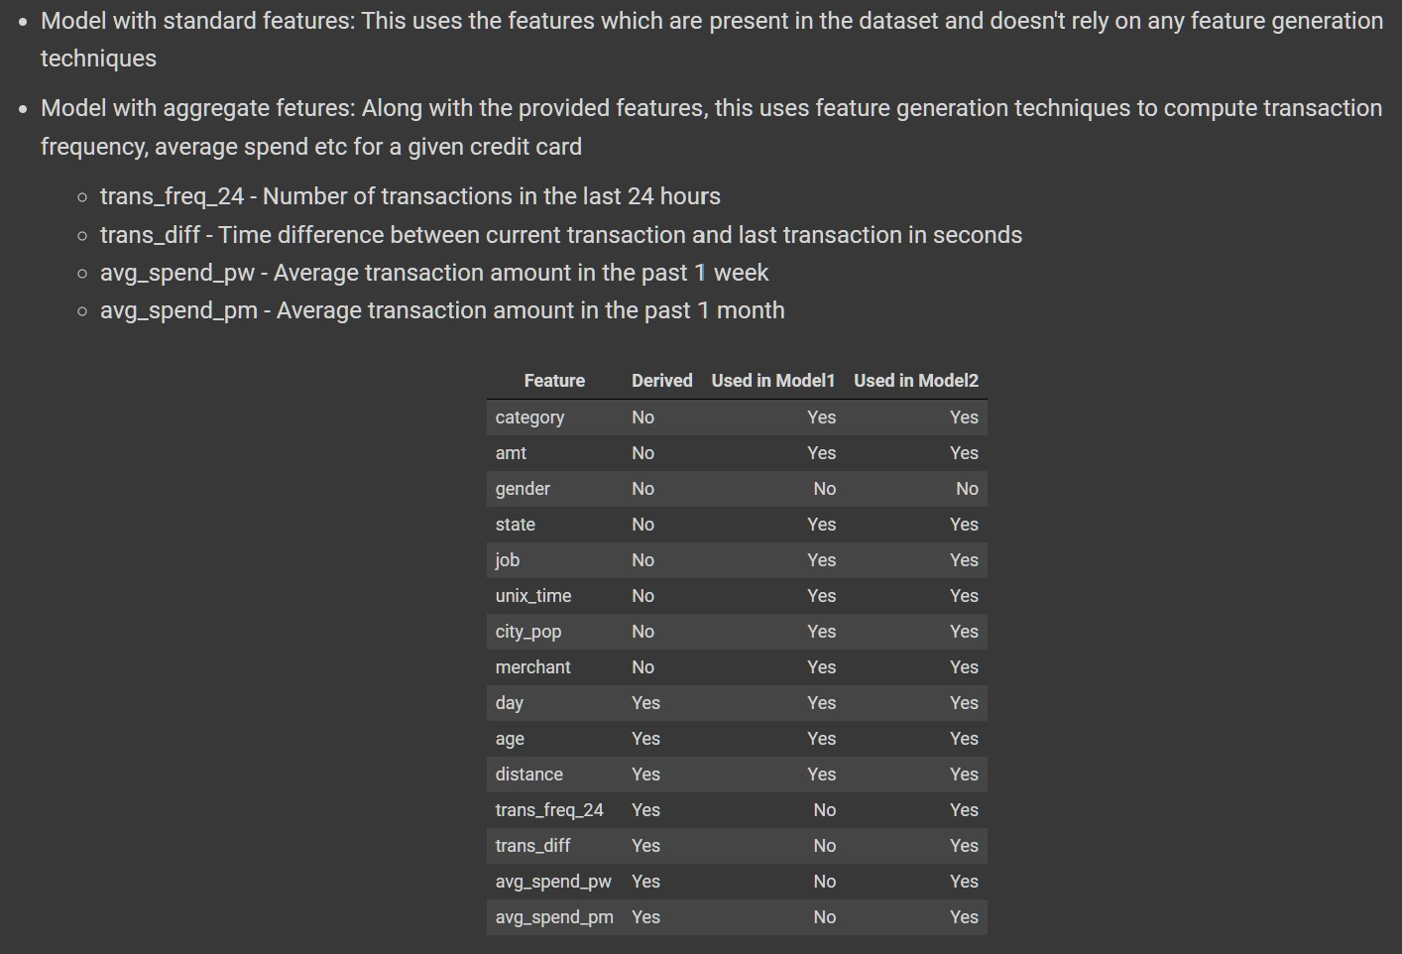
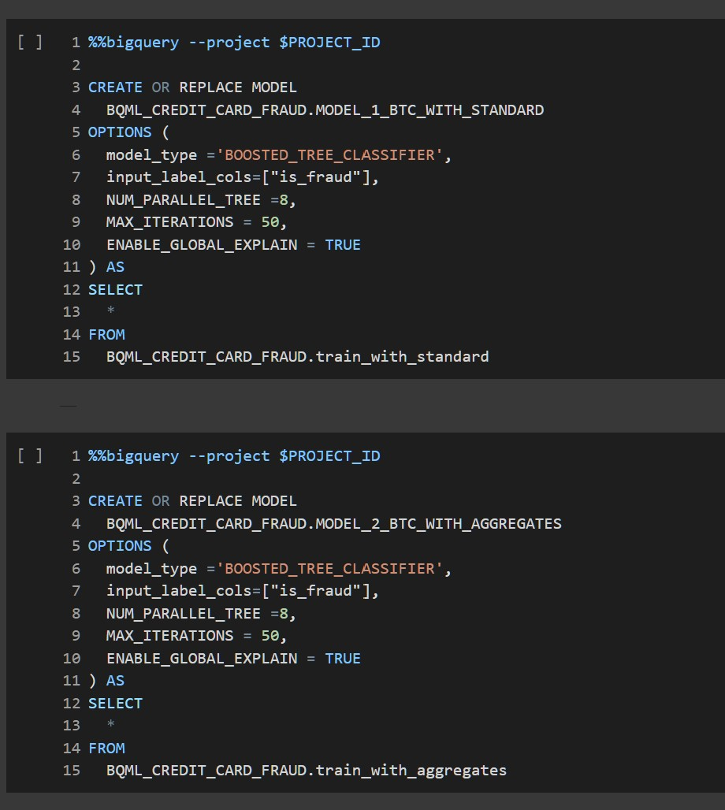
Model Training
Using two training dataset generated from the previous session, trained four models -
BigQuery: 2 Boost Tree Model, 1 DNN Model
TensorFlow: 1 Random Forest Model

Slide 8
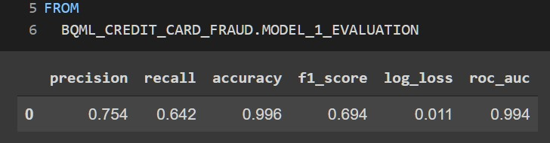
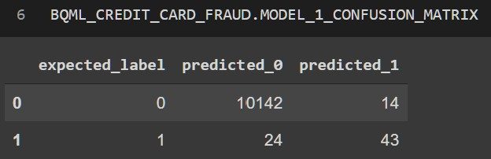
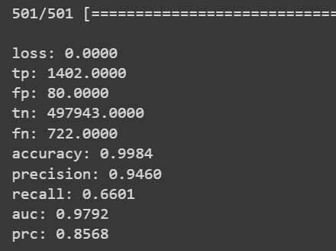
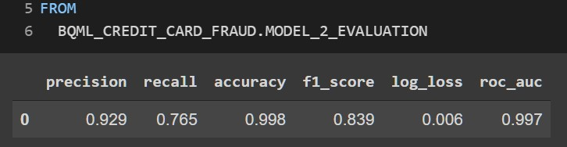
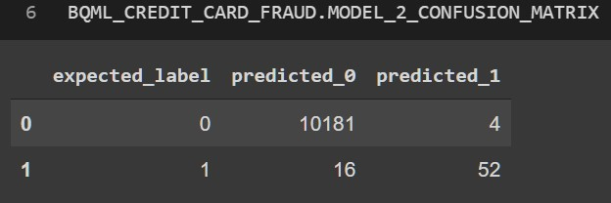
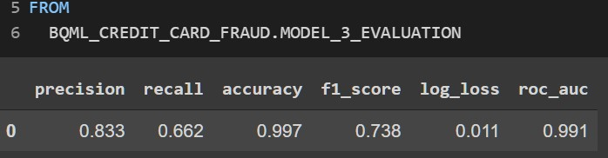
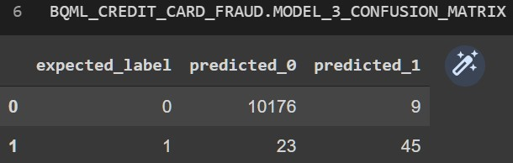
Model Evaluation and Comparison
Compare the performance of trained models - Overall performance comparison: 2 > 4 > 3 > 1
Model_1_Standard_BTC: Model_4_Aggregate_Random_Forest(Tensorflow):
Model_2_Aggregate_BTC:
Model_3_Aggregate_DNN:
F1_score: 0.7924

Slide 9
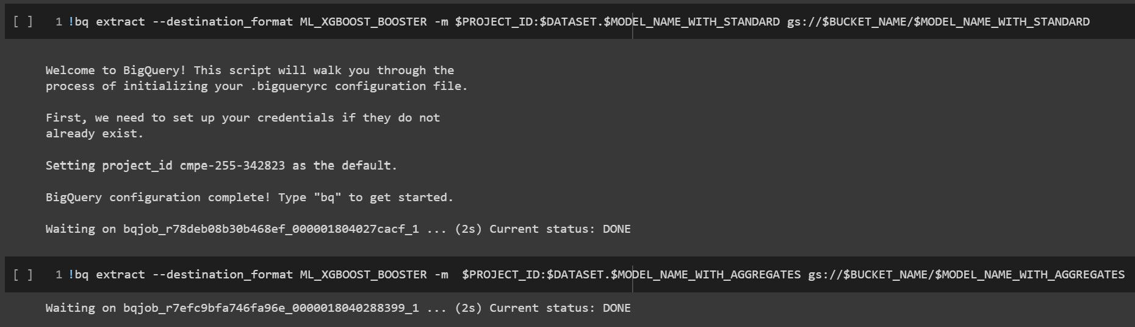
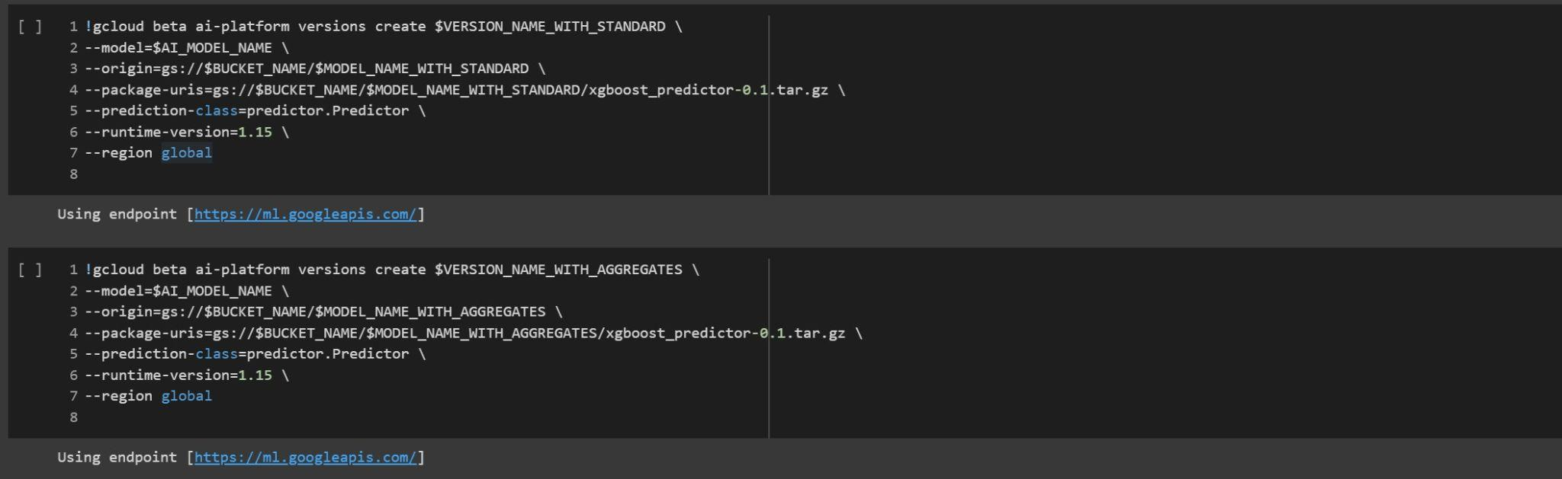
Model Exporting and Deployment
Model Exporting (Cloud Storage):
Model Deployment (AI Platform):

Slide 10
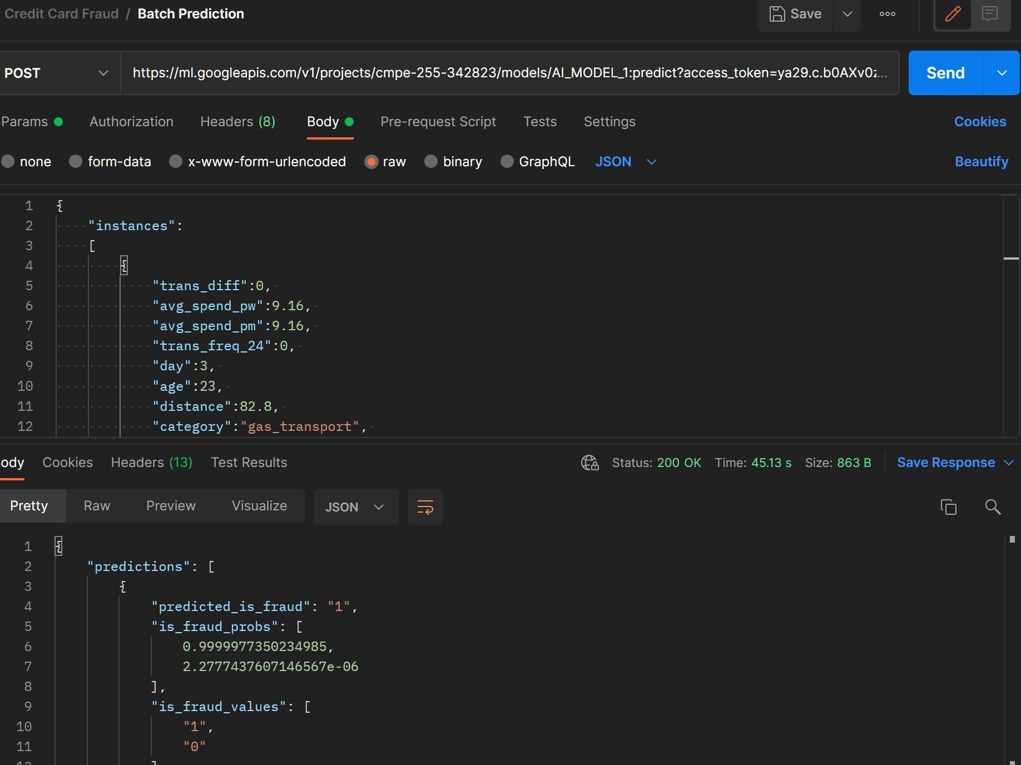
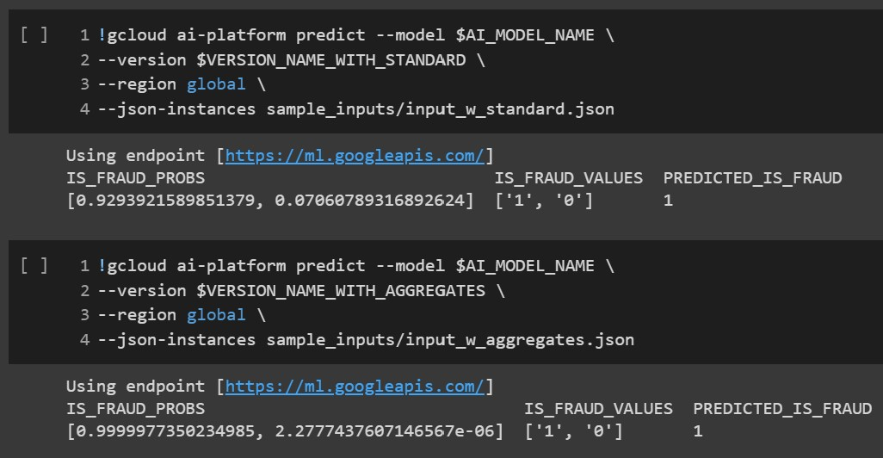
Model Prediction (batch processing)
Now we can test our models by sending transaction data to get the fraud detection prediction in real time!
Via Terminal RPC: Via Rest API:

Slide 11
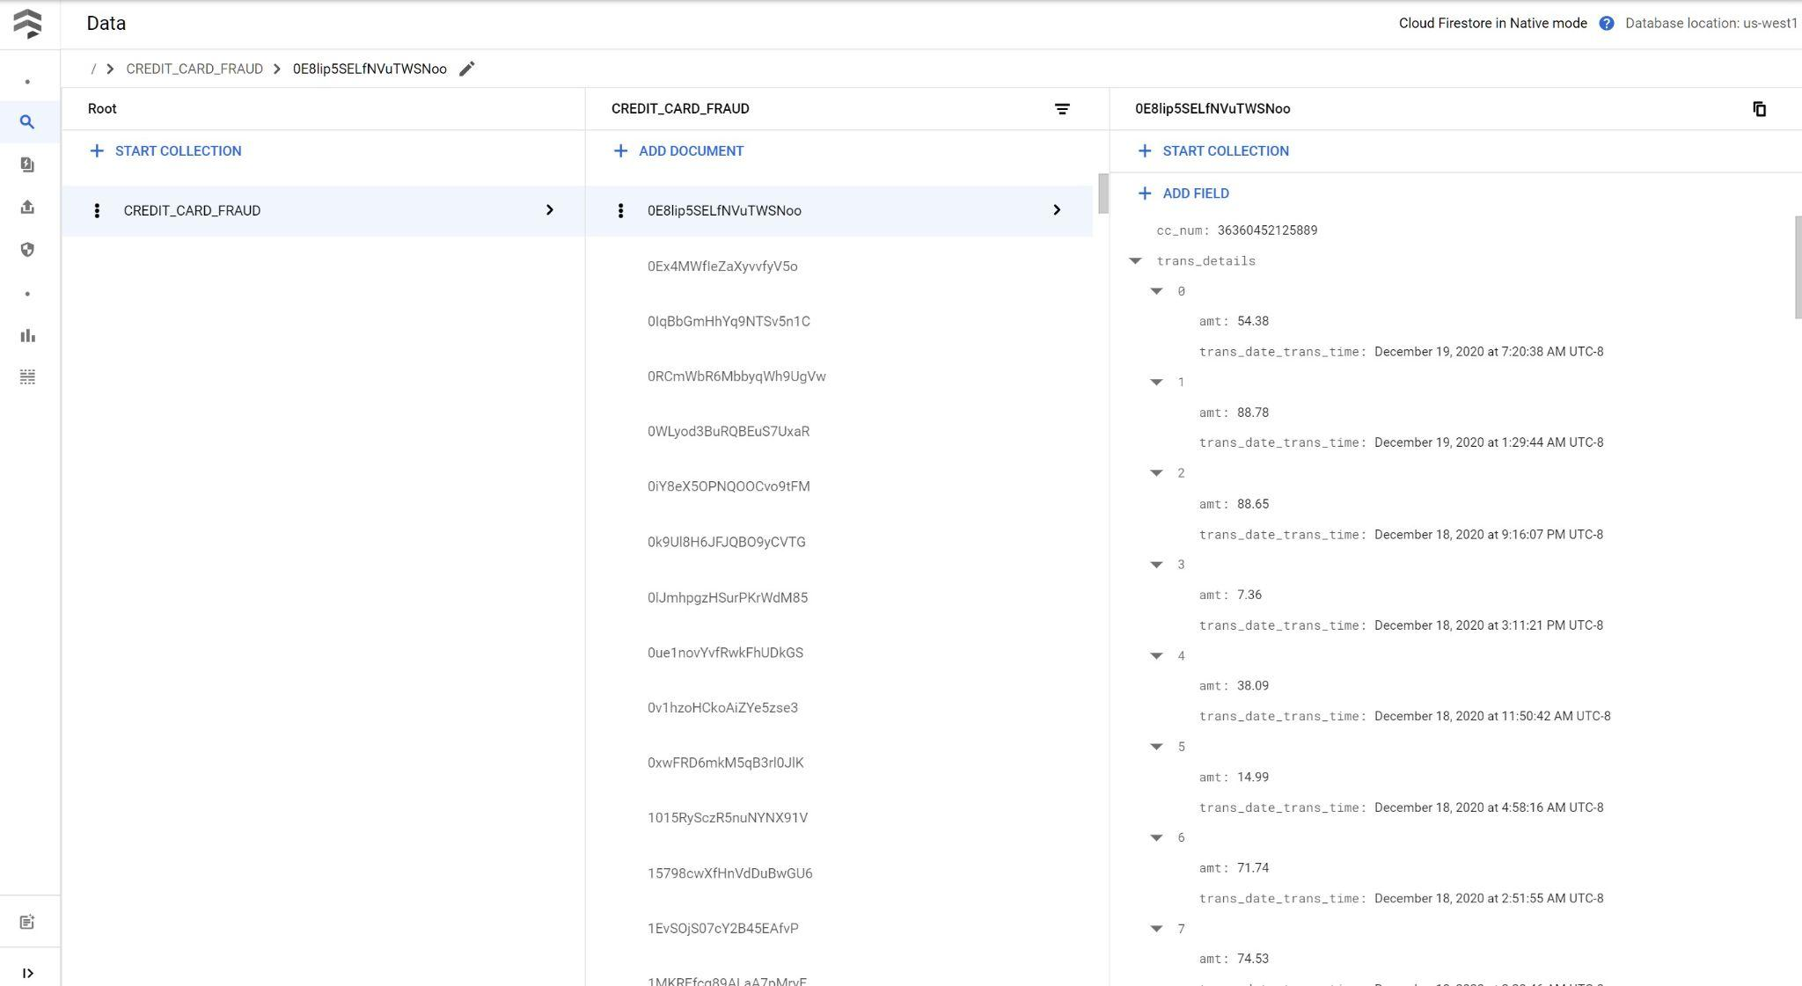
Firestore Setup(for stream processing)
To enable customer transaction history lookup/update in real time, we need to export these history to a cloud hosted database(Firestore).
Export data to Firestore:
Data overview in Firestore:

Slide 12
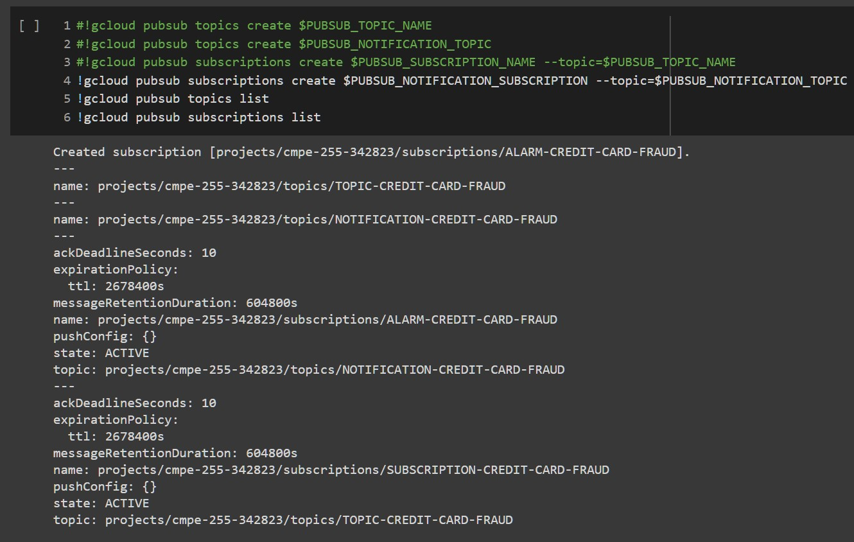
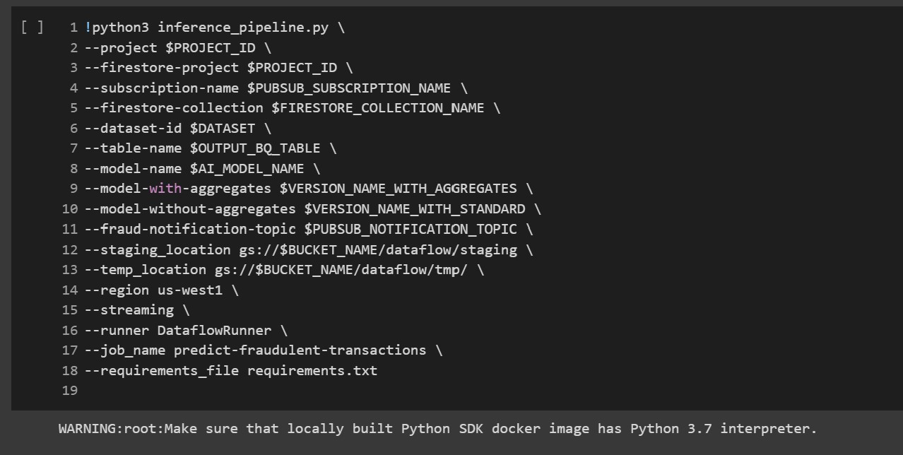
Pub/Sub and Dataflow Setup (for stream processing)
To enable stream processing, ML endpoint alone is not enough, we need Publisher and Subscriber to collect and process data in stream and a Dataflow job to regulate the flow of ingested data.
Setup Pub/Sub: Setup Dataflow:

Slide 13
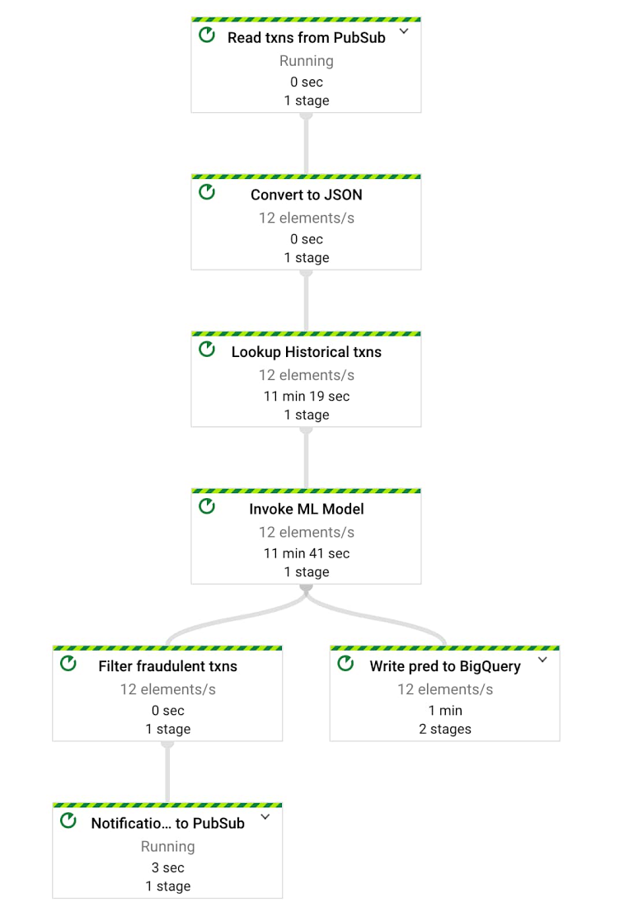
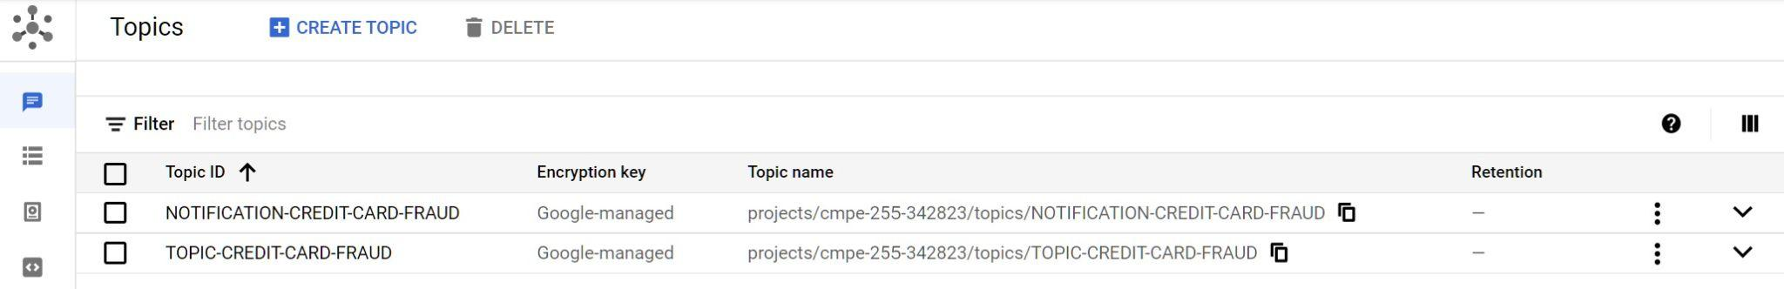
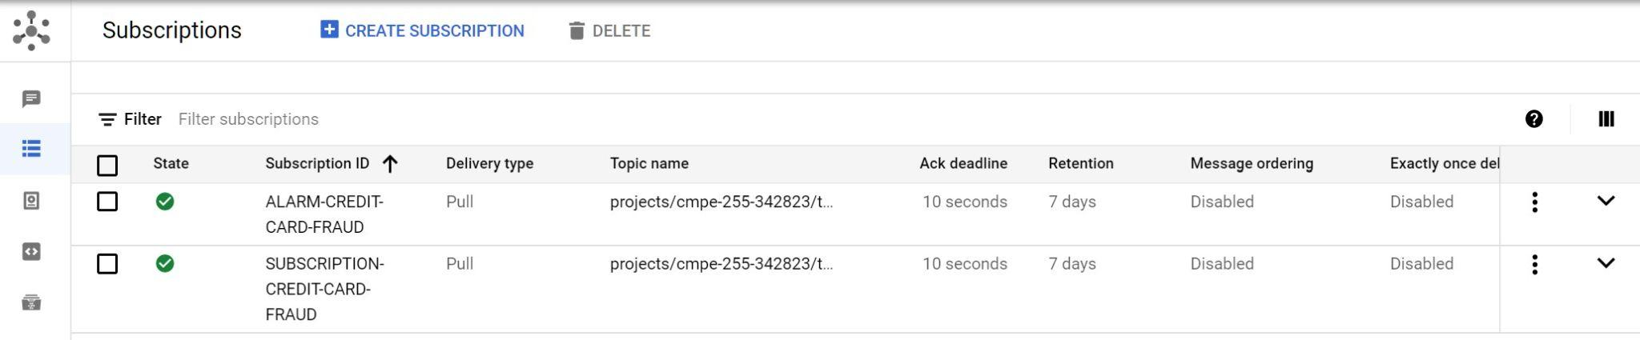
Pub/Sub and Dataflow Overview (for stream processing)
Everything has been set up! Now we only need to create a Publisher and start sending transactions to the topic.
Pub/Sub status overview: Dataflow job overview:

Slide 14
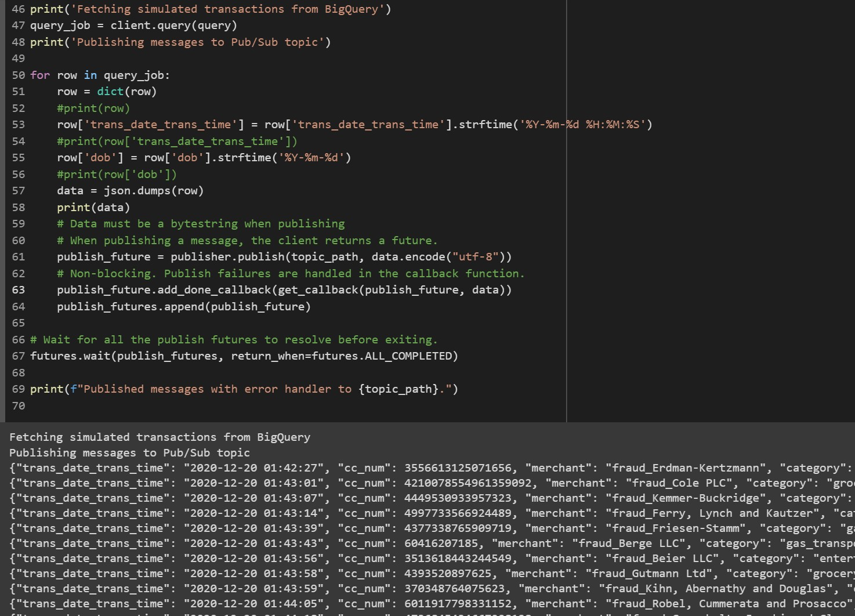
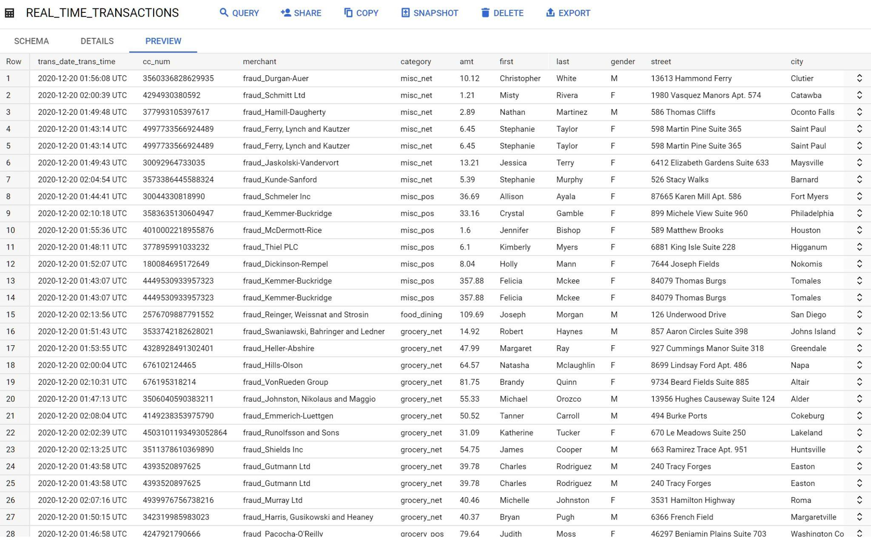
Model Prediction (stream processing)
We query part of the simulation data and send them to the Publisher for publishing in stream, and the corresponding Subscriber will be fetching them and feed them into the pipelined Dataflow job we hosted on cloud, then the ML endpoint will be invoked and start to predict the fraud probability for these transactions. At the end, the aggregate results (tranx + prediction) will be write into the real_time_transactions table in BigQuery.
Publish transactions in stream: Table updates in real time:

Slide 15
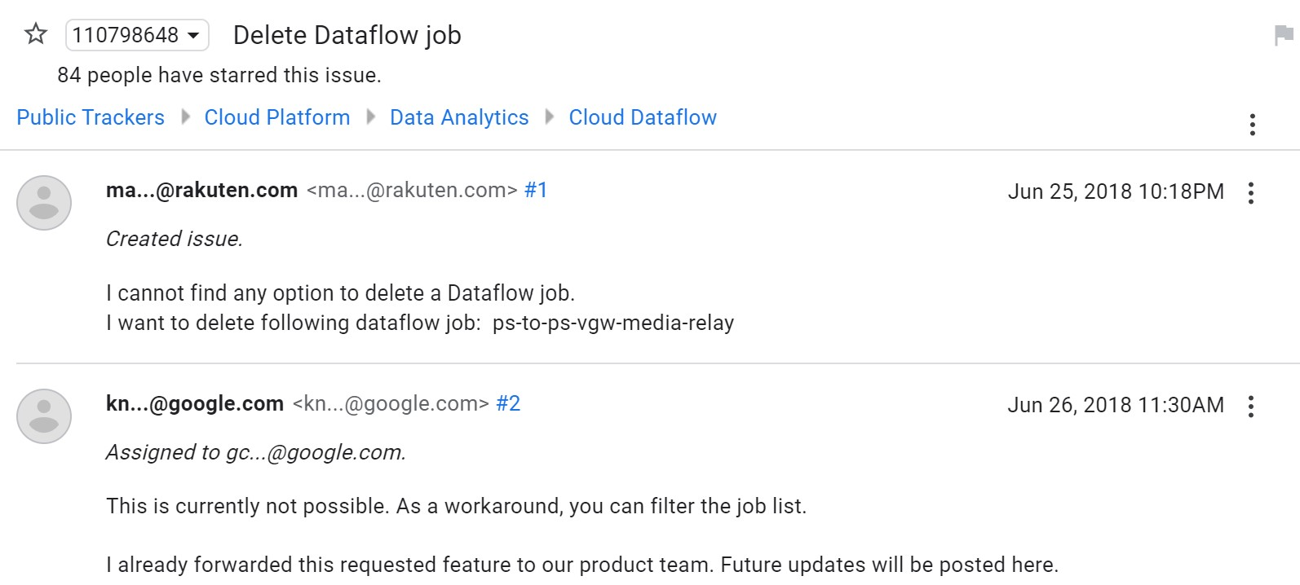
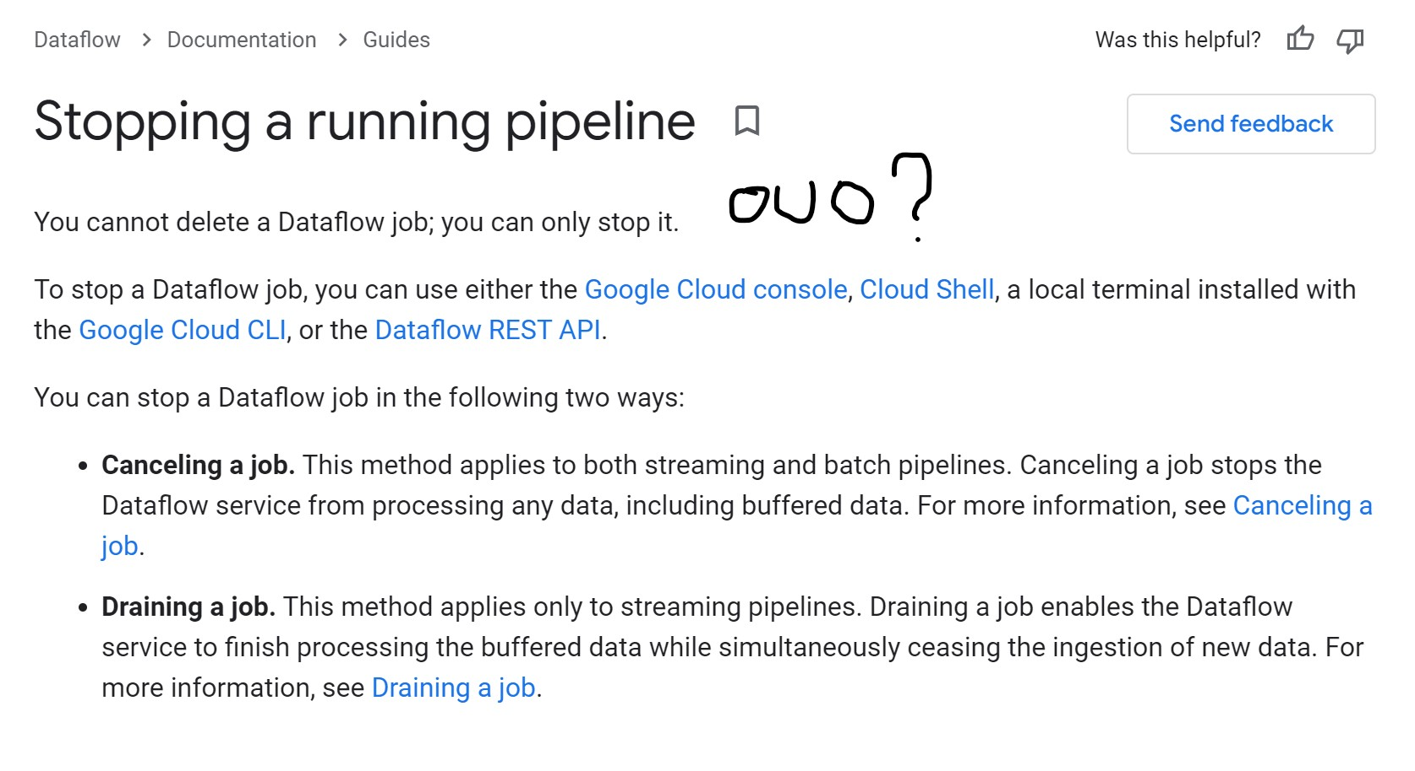
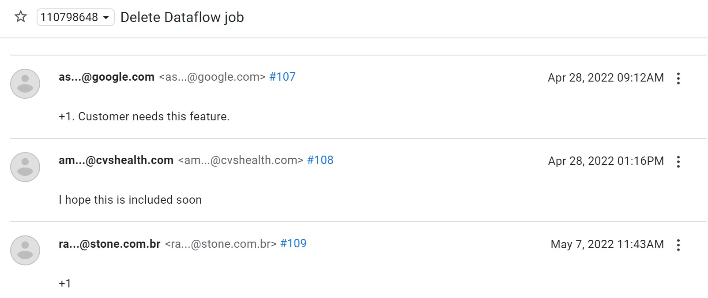
Some Funny Things…
You cannot delete a dataflow job (what!): And you still cannot delete it after 4 years (no joke!):

Slide 16
References
How to build a fraud detection solution| Google Cloud
Real Time Credit Card Fraud Detection | Gitlab
Credit Card Transaction Data Generator
BigQuery documentation | Google Cloud
BigQuery ML documentation | Google Cloud
Cloud Storage documentation | Google Cloud
Firestore documentation | Google Cloud
AI Platform documentation | Google Cloud
Pub/Sub documentation - Google Cloud
Dataflow documentation | Google Cloud
TensorFlow Decision Forests

